Slide 1
INTERSTITIAL LUNG DISEASES
Dr Shayo G A

Slide 2
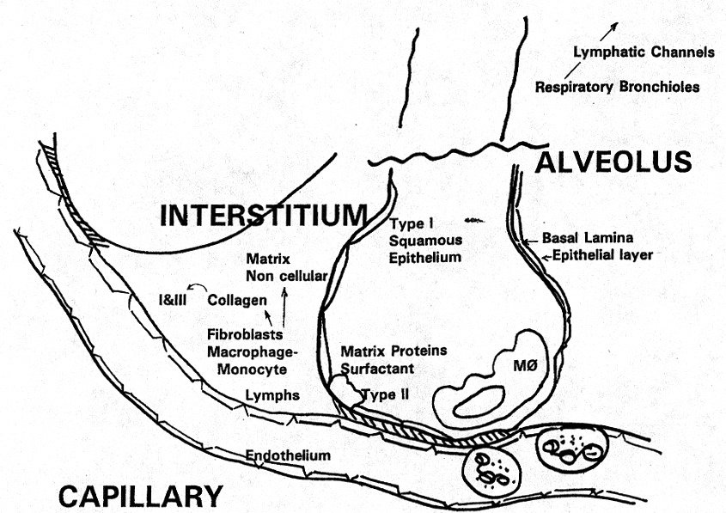
Lung Interstitium
The space between the alveolar epithelium and the capillary endothelium
Includes terminal airways, lymphatics, connective tissue and blood vessels.

Slide 3
Interstitial Lung Disease (ILD)
Diverse group of disorders characterized by inflammation and fibrosis involving the lung parenchyma or small airways
They share many common features
  Symptoms
  Radiographic appearance
  Pulmonary physiology derangement and histology

Slide 4
Classification
At least 200 recognized diseases which have a component of interstitial lung involvement either as a primary disease or as a significant part of multiorgan process.

Slide 5
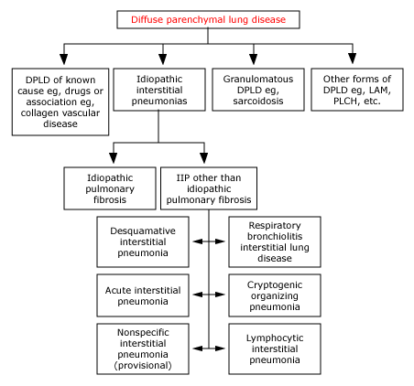

Slide 6
Approach to a case of ILD
Age:
  Pulmonary fibrosis is more common in elderly
  Sarcoidosis and Vasculitis more
common in middle aged
History: Symptoms
Breathlessness
Cough
Chest pain and hemoptysis

Slide 7
Approach to a case of ILD
Systemic sxs like wt loss, night sweats seen in conditions like chronic eosinophilic pneumonia
Personal history:
  Occupational: Exposure to dusts (organic/non organic)
  Medication:Some drugs may cause ILD

Slide 8
Physical Examination
Could be completely normal
Signs of respiratory distress
Bibasilar crackles
Finger clubbing commonly seen in IPF
Signs of right heart failure (cor pulmonale)

Slide 9
Diagnosis
CXR pattern is variable. Can be reticular, nodular or reticulonodular
Certain Xray findings are very diagnostic of a disease
  Hilar or Mediastinal adenopathy in
  Sarcoidosis
  Egg shell calcification in Silicosis
  Pleural involvement in Asbestosis and
  Connective tissue diseases

Slide 10
Radiographic Features
Upper lobe involvement
  Ankylosing spondylitis
  Berylliosis
  Histiocytosis X
  Silicosis
  Chronic hypersensitivity pneumonitis

Slide 11
Radiographic Features
High resolution CAT Scan (HRCT)
better detail of parenchyma
Can detect early ILD
Certain features are more indicative of a specific disease
Helps in choosing the site for biopsy (CT guided biopsy)

Slide 12
Pulmonary Function Testing
Mainly show restrictive pattern
Mixed restrictive and obstructive pattern seen in certain diseases like sarcoidosis, lymphanioleiomyomatosis, Histiocytosis X

Slide 13
Lung Biopsy
Done when unable to make diagnosis on clinical grounds
Techniques
  Transbronchial lung biopsy
  Video-assisted thoracoscopic lung biopsy
  Open lung biopsy

Slide 14
Diagnostic Process
History, physical examination, chest radiograph , PFTS
Dx: ILD (eg. Associated with exposures , drug related)
Possible ILD HRCT
diagnostic features
Biopsy

Slide 15
Idiopathic Pulmonary Fibrosis
(Cryptogenic Fibrosing Alveolitis)
An interstitial disease of unknown etiology.
Commonly seen in elderly.
Originally described by Hamman and Rich, it was a fulminant fatal form of interstitial pneumonitis

Slide 16
Clinical Presentation
Dyspnea insidious in onset, at least for 2-3 years
Dry cough
Physical exam
  Tachypnea
  Clubbing (70%)
  Bibasilar crackles “Velcro”
  Signs of Right sided heart failure

Slide 17
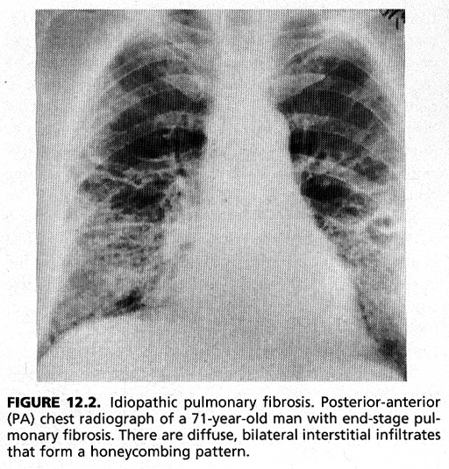
CXRay findings:
diffusely increased
reticular markings
esp. at the bases.

Slide 18
Treatment
Steroids
Other immunosuppressives like cytoxan, azathioprim, methotrexate, if steroids fail

Slide 19
Collagen Vascular Diseases
Systemic lupus erythematous
Rheumatoid arthritis
Progressive systemic sclerosis
Polymyositis and Dermatomyositis
Mixed Connective Tissue Diseases.
Sjogren’s syndrome

Slide 20
Systemic Lupus Erythematous
Unknown etiology commonly affecting young females
Usually involves the epidermis, vascular system, serous and synovial membranes
Pulmonary illness may be the presenting manifestation

Slide 21
Systemic lupus
Pleurisy with or without pleural effusion
Diaphragmatic Dysfunction
Acute lupus pneumonitis
Diffuse alveolar hemorrhage
Diffuse interstitial Disease
Pulmonary Hypertension
Pulmonary thromboembolism

Slide 22
Pleural Effusions
Usually small and frequently bilateral
It could be the isolated first sign
Exudative in nature
Finding of LE cell in fluid is diagnostic
High ANA Titre (> 1:160)
Excellent response to steroids.

Slide 23
Acute Lupus Pneumonitis
Presents with fever, cough and dyspnea.
Hypoxemia and Xray infiltrates present
Difficult to differentiate from pneumonia
Responds rapidly to steroids

Slide 24
Diffuse alveolar hemorrhage
Cough, Dyspnea and hemoptysis
Treatment is steroids/immunosuppressive
High mortality rate

Slide 25
Pulmonary Hypertension
Could be secondary to interstitial lung disease or primary due to fibroproliferative changes in pulmonary vessel.
Patient with lupus anticoagulant can have recurrent pulmonary embolism.

Slide 26
Rheumatoid Arthritis
Occurs predominantly in women
Pleural involvement usually seen in patients with advanced rheumatoid arthritis, with high RF titers.

Slide 27
Rheumatoid Arthritis
Pleurisy with or without effusion
Interstitial lung disease
Pulmonary Nodules
Bronchiolitis Obliterans Organizing Pneumonia (cryptogenic organizing pneumonia)
Bronchiolitis obliterans
Pulmonary Hypertension

Slide 28
RA-Pleural Involvement
Commonest manifestation
Rarely causes complications
Fluid characterized by low glucose: other differential of low glucose in pleural fluid (malignancy, infection)

Slide 29
RA-Interstitial Lung Disease.
Presents with cough, dyspnea and clubbing.
Responds well to steroids.

Slide 30
RA-Pulmonary Nodule
Histologically identical to subcutaneous nodule.
Could be single or bilateral with predilection for upper lobes.
Needs to be differentiated form malignancy.

Slide 31
Caplans’s Syndrome
Described in coal workers with rheumatoid arthritis.
Presence of rounded densities in these patients which undergo cavitation.

Slide 32
Sarcoidosis
Disease of unknown etiology which involves multiple organs but has the propensity to involve respiratory tract
It commonly effects young and middle aged adults
Occurs throughout the world, affects both sexes and all races
Predilection for adults < 40 yrs of age
The diagnosis is established when clinicoradiological findings are supported by histological evidence of noncaseating granuloma

Slide 33
Historical Perspective
English Physician, Jonathan Hutchinson is credited with the first description of this disease in 1877
Caesar Boeck, a Norwegian dermatologist coined the word sarcoid. He described skin lesions and used the term “sarkoid” as he felt they resembled sarcoma, except they were benign

Slide 34
Clinical presentation
Depends upon the organ involved
Duration of organ involvement

Slide 35
Respiratory sxs
Abnormal CXR
Dyspnea
Cough
Wheezing
Symptoms of pleural involvement

Slide 36
sxs
Cardiac : arrythmias, heart block
Ocular : uveitis
CNS : single cranial nerve palsy most commonly seventh nerve but can involve any part of the CNS
Skin : lupus pernio, erythema nodosum
musculoskeletal : monoarthralgia or polyarthralgias

Slide 37
Diagnosis
clinical diagnosis made from clinical presentation and a compatible CXR
Lab studies and tissue histology are obtained to confirm and support the diagnosis.
DDx: lymphoma, TB, Histoplasmosis, coccidiodomycosis, Beryllium exposure, Bronchogenic Ca.

Slide 38
Radiographic Presentation
Symmetrically enlarged bilateral hilar adenopathy
Enlarged paratracheal LN usually right sided and unilateral
Lung parenchymal involvement
  Occurs as disease progresses
  Infiltrates are bilateral
  Patchy upper and middle lobe, fibrosis at end stage.

Slide 39
Radiographic classification
Stage I -bilateral hilar adenopathy
Stage II -bilateral hilar adenopathy and diffuse parenchymal disease
Stage III -diffuse pulmonary infiltrate without hilar adenopathy
Stage IV –Parenchymal fibrosis

Slide 40
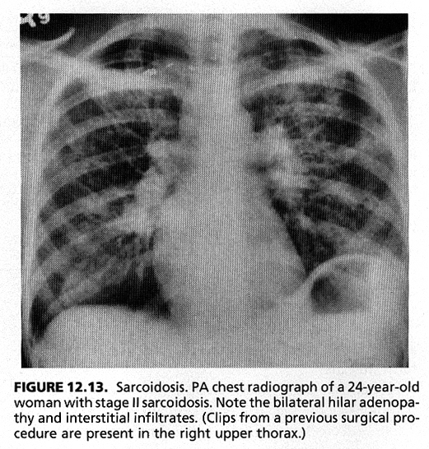

Slide 41
Lab Tests
Leukopenia, occurs in 30% of patients
LFT abnormality
Renal function abnormality
During active disease pts usually have anergy to common fungal and tuberculin antigen.
ACE antigen (angiotensin converting enzyme)

Slide 42
Serum ACE Levels
Converts angiotensin I to angiotensin II
Usually produced by capillary endothelial cells, also produced by alveolar macrophages.
Elevated in 60% of patients with active disease.
  Also elevated in cases of silicosis, asbestos exposure, Gauchers dis, leprosy, coccidiodomycosis, miliary TB, IBD.

Slide 43
Bronchoscopy
Reveals cobblestone appearance of mucosa
BAL- Increased % of lymphocytes mainly T lymphocytes in BAL fluid.
There is increased number of T helper cells and reduced number of T suppressor cells.

Slide 44
Bronchoscopy
Transbronchial biopsy has a good yield
  It is up to 60% positive in pts with no parenchymal disease
  In pts with parenchymal dis up to 80% positive
Non caseating granuloma is seen
  composed of epitheloid cells and multinucleated giant cells, surrounded by cuff of lymphocytes and plasma cells

Slide 45
Treatment
Different for pulmonary and extra pulmonary sarcoidosis
  Sarcoid involving any of the vital organs (eye, CNS, cardiac) and hypercalcemia needs immunosuppressive treatment

Slide 46
Treatment
Pulmoary sarcoidosis
  Stage I (asymptomatic patient)
    No need for treatment.
    73% remit spontaneously in first 18-24 months.
  Pts with respiratory symptoms
    Having 20-30% reduction in lung volumes and DLCO need Steroid treatment.

Slide 47
Inhalational Diseases
ILD secondary to inhalation of inorganic dust are reffered to as Pneumoconiosis
Hypersensitivity Pneumonitis is ILD secondary to inhalation of organic dust.

Slide 48
Inhalational diseases
Free silica
Silicates
Asbestos
Coal
Metals Beryllium, Cobalt

Slide 49
Silicosis
Inhalation of free crystalline silica dust
Foundry worker, sandblaster, tunneling, pottery making, polishing and manufacture of glass, tiles and bricks.
Dx: history of exposure
  Chest xray with upper lobe nodules with egg shell calcifications of hilar nodes.

Slide 50
Silicosis
Patients at high risk for typical as well as atypical Mycobacterial infections
  Try to avoid exposure toTB
  Annual PPD testing.

Slide 51
Asbestos
Shipyard workers, pipe fitters, welders, sheet metal workers, workers involved in automotive repair especially brake lining work.

Slide 52
Pulmonary complications
Asbestosis: pulmonary fibrosis sec. to asbestos exposure
Pleural thickening/pleural plaques
Pleural effusions
Rounded atelectasis
Mesothelioma ( pleural malignancy)
Bronchogenic carcinoma

Slide 53
Coal Worker Pneumoconiosis
Coal is carbonaceous material
Silica can be found mixed in it
Occurs either as simple form or complicated form.
  Simple CWP: nodules which are < 1 cm in size with predilection for upper lobes.
  Complicated CWP: Nodules of density > 1cm in size

Slide 54
Hypersensitivity Pneumonitis
Secondary to inhalation of organic dust derived from animal dander and proteins or saprophytic fungi contaminating water reservoir, dairy products, wood bark and animal droppings.
Actinomycetes is the commonest etiologic agent, thought to be a fungi is actually a bacteria

Slide 55
Presentation
Acute: Brief intense exposure, leading to flu like illness
Subacute: Less intense but prolonged expsoure, leading to cough, dyspnea, fatigue, poor appetite and malaise
Chronic: Persistance of above symptoms for longer period.
  Biopsy reveals inflammatory cells, granuloma formation and fibrosis

Slide 56
HP
HRCT useful in differentiating Interstitial Pulmonary Ffibrosis
  Micronodules
  Ground glass opacities
Treatment :
  Removal of antigen source
  Chronic course of steroid

